Slide 1
Fixed CAN Communication
FSE RACING KIT
Notes:
DE/EN abgeglichen 26.02.2022

Slide 2



Fixed CAN Message Configuration
Data transmission CAN Bus 2.0A (11-bit identifier format - 'base frame format') The data messages are 8 bytes long and are transmitted in Intel format (Little-endian - example Day.Month.Year) Variable ‘Transmission rate’ Variable ‘Output rate’ Telegram failure monitoring
fixed
3 clearly defined CAN messages Clearly defined CAN messages are implemented for exchanging data. AMK Actual Values 1 AMK Actual Values 2 AMK Setpoints 1

Slide 3
Cycle Times
Control bits and setpoints
are read by the inverter
every 1 ms cycle (fixed).
fixed
Transmission rate in kBit/s (0 = default 500 kBit/s)
(possible 100, 125, 250, 500, 1000 kBit/s)
Configurable output rate of
status bits and actual values
in ms (0 = default value 5 ms) (possible 1, 2, 3... 100 ms)

Slide 4
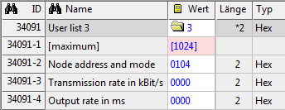
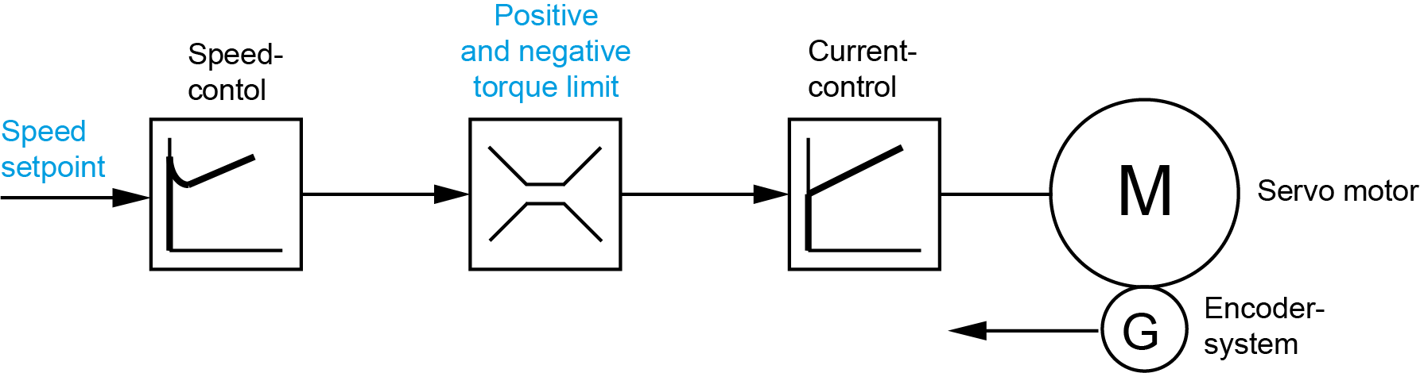


Special Features
Konfiguration
2
ID34091 User List
1
Configuration of node address, transmission rate and output rate with AIPEX PRO
Variant 2: Torque control through torque limitation
+ dynamic speed limitation (included speed controller)
Variant 1: Torque control
is only possible with the 'Free CAN message configuration'
Telegram failure monitoring (Fixed configuration):
Enable: Automatic with first received data telegram
Error message when telegram failure > 50 ms
Reaction: Coast (setpoint torque 0 %MN)

Slide 5
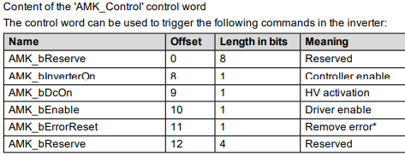
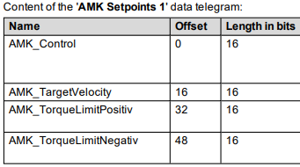
Data Telegrams with Fixed Content
3 clearly defined CAN messages AMK Actual Values 1 AMK Actual Values 2 AMK Setpoints 1
Example:
See device description:
Formula Student Racing Kit

Slide 6
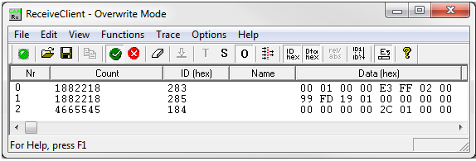
3 Clearly Defined CAN Messages
AMK Actual Values 1 (0x282+n)
AMK_Status
AMK_ActualVelocity
AMK_TorqueCurrent
AMK_MagnetizingCurrent
CAN analyzer
AMK Actual Values 2 (0x284+n)
AMK_TempMotor
AMK_TempInverter
AMK_ErrorInfo
AMK_TempIGBT
AMK_TorqueLimitNegativ
AMK_TorqueLimitPositiv
AMK_TargetVelocity
AMK_Control
AMK Setpoints 1 (0x183+n)

Slide 7
Example
Configuration

Slide 8
AIPEX Configuration
The CAN configuration is parameterized with AIPEX in each inverter (ID34091 'User list 3')
(fixed CAN configuration mode = Code 0x04)
fixed
ID34091 'User list 3'
32901 | 3 | Current list length (counted from element 2)
32901-1 | [1024] | Maximum possible list length (not changeable value)
32901-2 | 0000 | (High byte) node address and (Low Byte) CAN configuration mode
32901-3 | 0000 | Transmission rate in kBit/s (0 = default 500 kBit/s) (possible 100, 125, 250, 500, 1000 kBit/s
32901-4 | 0000 | Output rate in ms (0 = default value 5 ms) (possible 1,2,3… 100 ms)
Default element length: 2 byte
Default element type: Hex
[high byte] Node address 1 and [low byte] 4 CAN configuration mode fixed
Transmission rate 500 kBit/s
Output rate 5 ms

Slide 9
Node Address
Inverter 2
Inverter | Node address | ID34091 'User list 3' | Hex code
Inverter 1 | 1 | ID34091-2 | 0x0104
Inverter 2 | 2 | ID34091-2 | 0x0204
Inverter 3 | 5 | ID34091-2 | 0x0504
Inverter 4 | 6 | ID34091-2 | 0x0604
Inverter 1
2
1
6
5
Inverter 4
Inverter 3
Beware of the
same can identifier

Slide 10
Calculation CAN Identifier
Node address + Basic address = CAN Identifier
Inverter 1
Inverter 2
Inverter | Node address | ID34091 'User list 3' |  | CAN Identifier | CAN Message
1 | 1 | 0x0104 | 0x282+01 0x284+01 0x183+01 | 0x283 0x285 0x184 | AMK Actual Values 1 AMK Actual Values 2 AMK Setpoints 1
2 | 2 | 0x0204 | 0x282+02 0x284+02 0x183+02 | 0x284 0x286 0x185 | AMK Actual Values 1 AMK Actual Values 2 AMK Setpoints 1
3 | 5 | 0x0504 | 0x282+05 0x284+05 0x183+05 | 0x287 0x289 0x188 | AMK Actual Values 1 AMK Actual Values 2 AMK Setpoints 1
4 | 6 | 0x0604 | 0x282+06 0x284+06 0x183+06 | 0x288 0x290 0x189 | AMK Actual Values 1 AMK Actual Values 2 AMK Setpoints 1
2
1
6
5
Inverter 4
Inverter 3
Beware of the
same can identifier

Slide 11
3 Clearly Defined CAN Messages
AMK Actual Values 1 (0x282+n)
AMK_Status
AMK_ActualVelocity
AMK_TorqueCurrent
AMK_MagnetizingCurrent
CAN analyzer
AMK Actual Values 2 (0x284+n)
AMK_TempMotor
AMK_TempInverter
AMK_ErrorInfo
AMK_TempIGBT
AMK_TorqueLimitNegativ
AMK_TorqueLimitPositiv
AMK_TargetVelocity
AMK_Control
AMK Setpoints 1 (0x183+n)

Slide 12
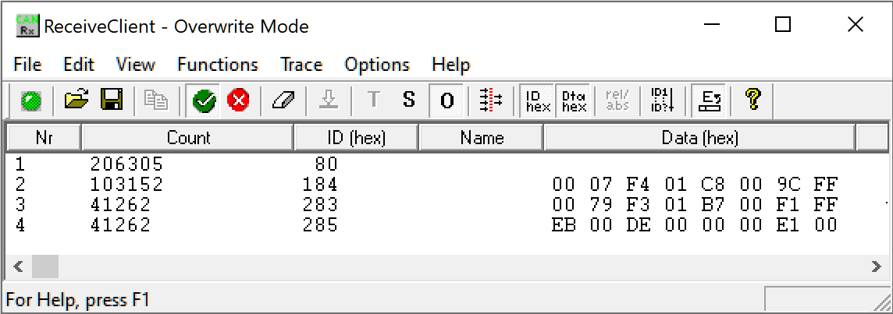
Example: Conversion Inverter Temperature
AMK Actual Values 2 (0x284)
AMK_TempMotor
AMK_TempInverter
CAN analyzer
Format-Intel | DE | 00
Format-Motorola | 00 | DE
DEC | 222
Scaling 0.1 AMK_TempInverter | 22.2°

Slide 13

Little-Endian / Intel-Format
The data messages are 8 bytes long and are transmitted in Intel format (Little-endian).
When transmitting data, the low-order value is listed first. Example for positive and negative values:
1. | Setpoint value <Torque limitation positive> | 30 %MN
2. | The torque scaling is 0.1 %MN | 300 (dec)
3. | Conversion into hex (Big-Endian / Motorola-Format) | 01 2C (hex)
4. | Switch to Little-Endian / Intel-Format | 2C 01 (hex)
1. | Setpoint value <Torque limitation negative> | -30 %MN
2. | The torque scaling is 0.1 %MN | -300 (dec)
3. | Conversion into hex (2 BYTE = 1 WORD!) (Big-Endian / Motorola-Format) | FE D4 (hex)
4. | Switch to Little-Endian / Intel-Format | D4 FE (hex)
Set calculator
to 'WORD' format

Slide 14
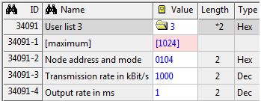
Examples
fixed
AIPEX configuration example with default values
High byte) node address = 0x01
(Low Byte) Fixed configuration = 0x04
Transfer rate in kBit / s = 0 = default value 500 kBit / s
Output rate in ms = 0 = default value 5 ms
AIPEX configuration example with variable transmission and output rate
(High byte) node address = 0x01
(Low Byte) Fixed configuration = 0x04
Transmission rate in kBit / s = 1000
Output rate in ms = 1

Slide 15
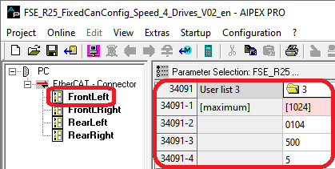
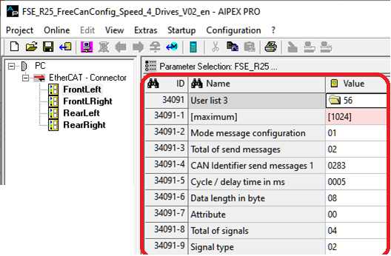

Fixed and Free CAN messages configuration
Example:
Free configuration with same message content as Fixed configuration
FSE_R25_FixedCanConfig_Speed_4_Drives_V02_en
FSE_R25_FreeCanConfig_Speed_4_Drives_V02_en
See training documents:
Training RACING KIT EN V01 2022 / AIPEX PRO Examples

Slide 16
ToDO
Video CAN configuration
Motorola Format - big-endian - most significant component byte stored first (example Hour:Minute:Second)
Intel Format - little-endian - least significant component (byte) stored first (example Day.Month.Year)
8 Bit = 1 Byte = 0x00
16 Bit = 2 Byte = 1 Word = 0x0000

Slide 17
3 clearly defined CAN messages
Description of the data telegrams
CAN analyzer
Control bits and setpoints (CAN controller Inverter)
AMK Setpoints 1 (0x183) | Control word (Controller enable, HV enable, drive enable, clear error) Speed setpoint Torque limitation positive Torque limitation negative
 |  | 99 | FD | 19 | 01 | 00 | 00 | 00 | 00
 |  |  |  | 01 | 19
 |  |  |  | 281 x 0.1C°
 |  | AMK_TempMotor |  | AMK_TempInverter |  | AMK_ErrorInfo |  | AMK_TempIGBT

